Slide 1
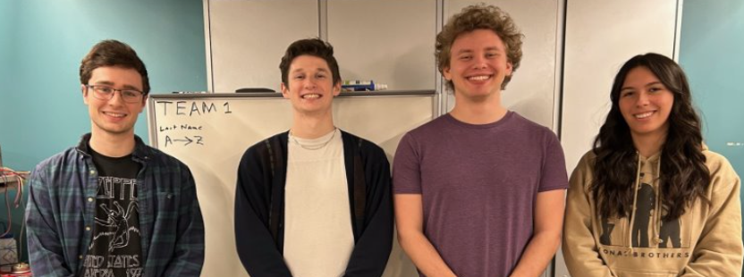
ECE 477 Final Review: Team # 1

Slide 2
Outline
Project Overview
Block Diagram
Design Challenges
Individual Contributions
Project Video Demonstration
Questions

Slide 3
Project Overview
The Dungeon Crawler is an interactive electronic game board used to customize and simulate dungeon crawling games
Laptop application is used to design the map and characters, and the USB ports info to board
Game board utilizes pixels and Hall Effect (magnetic) sensors to display map and track characters
LCD and keypad display prompts and receive inputs for gameplay
Acts as a D&D "gaming console" for small groups

Slide 4
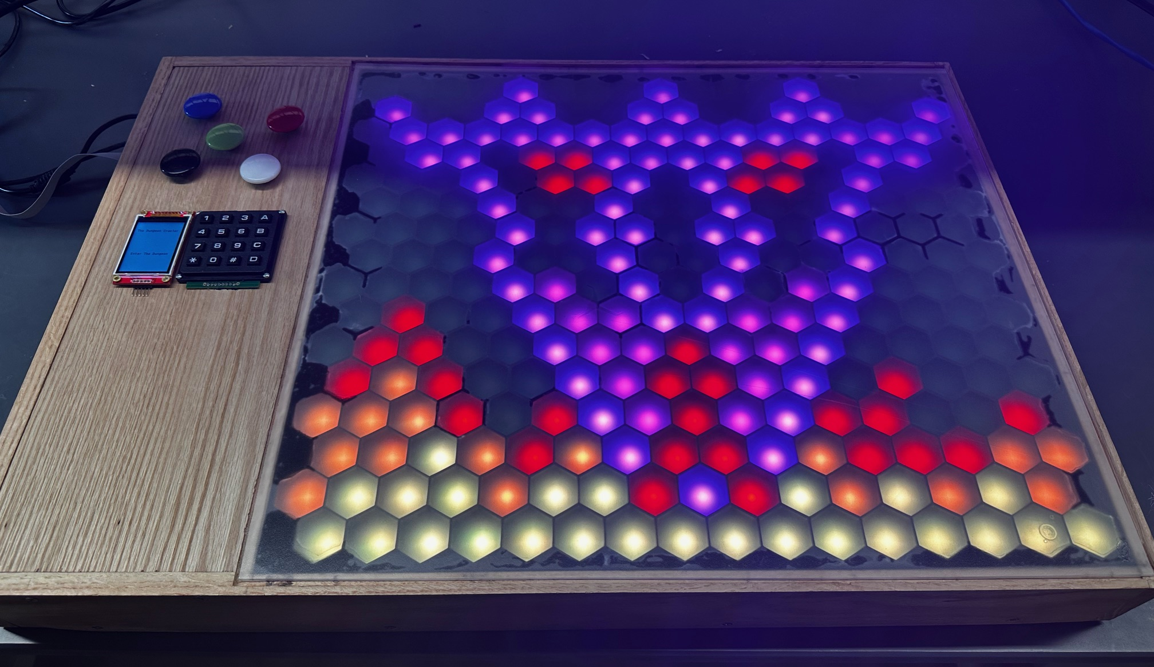
PROJECT OVERVIEW

Slide 5
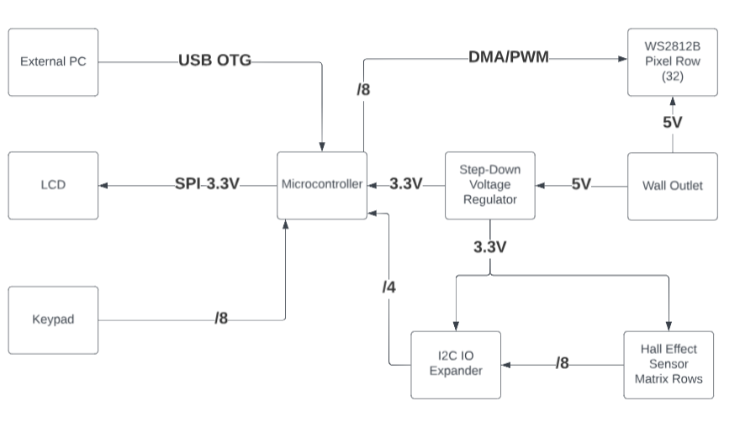
Block Diagram

Slide 6
Design Challenges
WS2812B Pixels
Timer and DMA conflicts
Floating voltages in data line
17 PCBs to solder, with over 1000 components altogether
Several connections between boards, multiplying potential problems
Mechanical Design Constraints
Fitting PCBs, hex dividers, and plastic top
Weak solder connection on USB port
Application
Inconsistency in exporting characters and map
Designing Unity UI to be user-friendly
Paradoxical acrylic glue

Slide 7
Individual contributions
Landon Carre
WS2812B and I2C I/O Expanders
Prototyped lighting in series
Prototyped I2C communication to multiple addressed MCP23017s
LED and Hall Effect Sensor PCB Design
Soldering/PCB Manufacturing
Soldered components and ran system design checks on completed boards
Gameplay Code Contributions
Focused on the movement, combat, and chests
Final Packaging
Helped insert PCBs and other components into wooden frame

Slide 8
Individual contributions
Neil Brown
USB Protocol
Developed USB OTG protocol
Designed circuit for USB
Tested and extended previously written software
Soldered PCBs
Hot plated gameplay PCBs, hand soldered USB and SD reader to main PCB
Gameplay Code
Created game loop state that controls player turns
Helped with line of sight and FOV algorithms
Final Packaging
Created holes for power and USB connectors, data lines for LCD and keypad

Slide 9
Individual contributions
Jackson Luna-McCrocklin
Software Outline
Developed object-oriented structure and pathing algorithms
Prototyped Components
Focused on LCD and keypad, helped with Hall Effect sensors
Designed, soldered, and debugged most of main PCB, helped with the other 16 PCBs
Final Packaging
Designed container and found manufacturer
Software Outline (Again)
Wrote portion of software flowchart, outlined state machine format
Developed Firmware
Helper functions for LCD, interrupts for keypad
Debugging Game Logic
Focused on FOV and ranged combat, contributed to initialization of monsters

Slide 10
Individual contributions
Grace Whitaker
Companion Application
Designed interactive UI for map and character editing
Parsed and exported map and character information via USB
Prototyping
Focused on MicroSD reader, helped with USB OTG
PCB Assembly
Hot plated and hand soldered components on the 16 gameplay PCBs
Final Packaging
3D modeled and printed hex dividers to go underneath acrylic display
Cut plywood and acrylic top for playing area
Filled out remainder of the software flowchart and debugged gameplay code

Slide 11
Project Demonstration
PSDR #1 (Software): An ability to simulate a turn-based combat game involving pathing algorithms and object-oriented class systems.
PSDR #2 (Software): An ability to customize maps and characters on a computer via a Unity-based application.
PSDR #3 (Hardware): An ability to control rows of LED strips with DMA and PWM on microcontroller GPIO pins.
PSDR #4 (Hardware): An ability to control an array of Hall Effect sensors with I2C I/O expanders on a microcontroller.
PSDR #5 (Hardware): An ability to port information from a computer to a microcontroller via USB OTG.

Slide 12
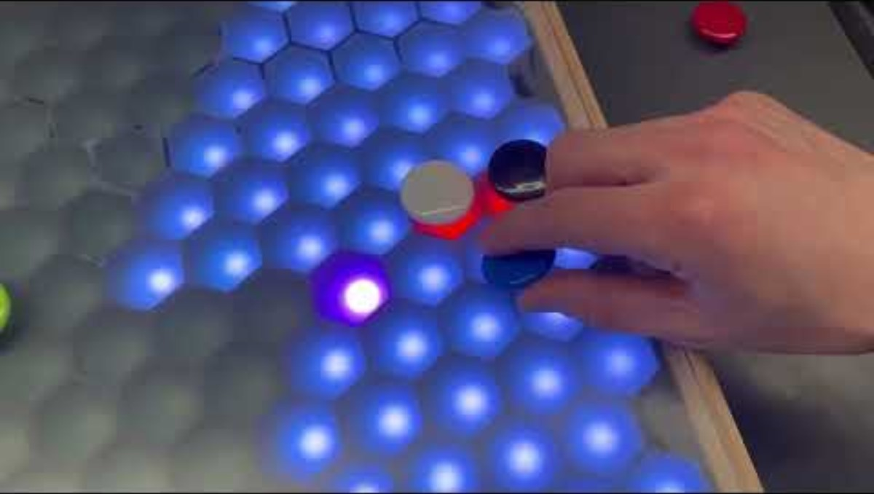
Project Demonstration VIDEO
https://youtu.be/Y_AnHLYayX4

Slide 13
Questions?

